Slide 1
Public Safety Communications Upgrade Project
Emergency Services Update
July 23, 2015

Slide 2
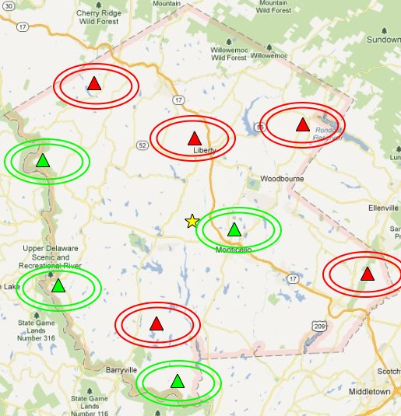
Current Infrastructure Status
Construction and/or modification of (5) towers completed
Construction on (2) towers set to begin within the next 2 weeks. (Tusten & Delaware)
Environmental reviews on the last (2) towers in progress with construction bids going out in the next few weeks

Slide 3
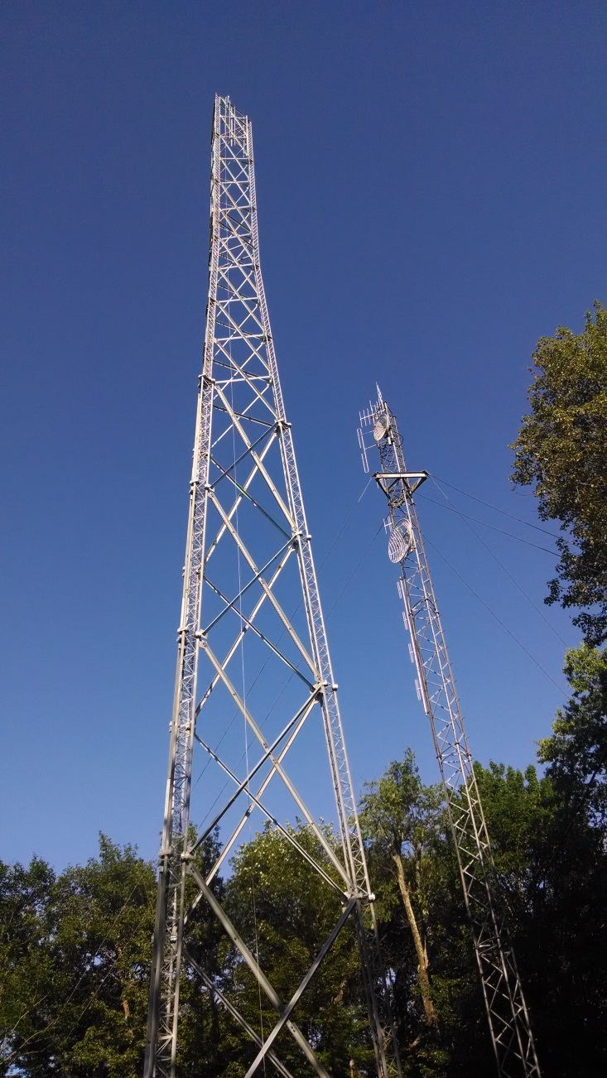
Tennanah Lake

Slide 4
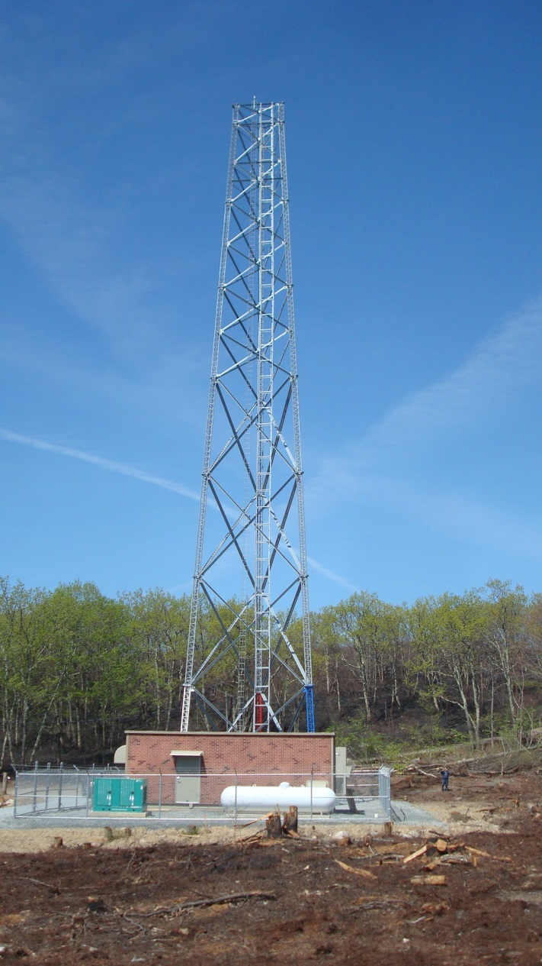
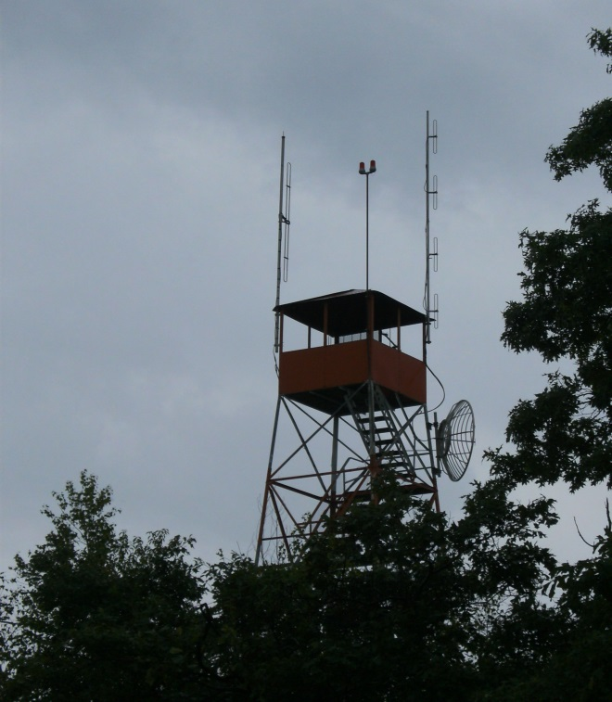
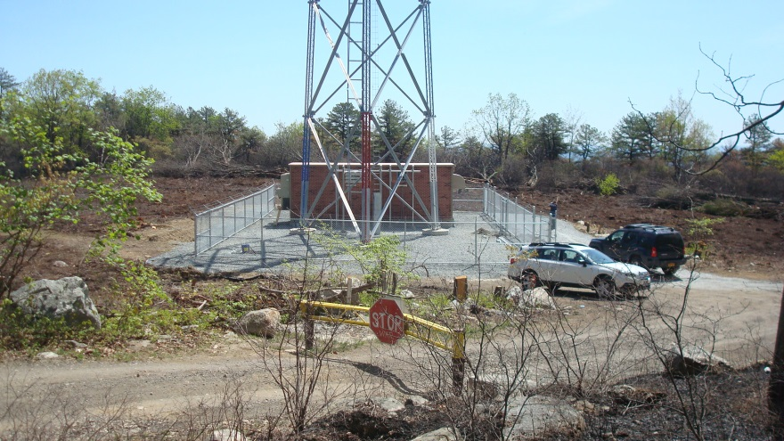
Wurtsboro

Slide 5
Current Systems Status
Microwave interconnect surveying and engineering has been completed.
Microwave procurement completed ($1.4million June 2015)
CDR in progress with Motorola (Core system, batteries, backup, consoles, recorders, rack layouts, etc.)
Final review of FCC licensing

Slide 6
Timeline moving forward
Fall 2015
Continue Infrastructure
Begin equipment installation
Winter/Spring 2016
Complete infrastructure
Continue installation
Summer/Fall 2016
Final installation & testing
Winter 2016
Move select services to new system for testing
Spring/Summer 2017
Begin to migrate Fire & EMS to new system

Slide 7
Coverage
Spec for 95% mobile road coverage
Simulcast & Voting
In-Building coverage
VHF high band will provide better penetration
Talkback to/from tower will still have weak spots
Mobile on-scene should continue to be primary mode of communications

Slide 8
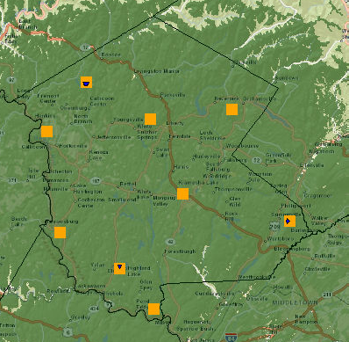
Coverage Projection (Mobile Inbound)

Slide 9
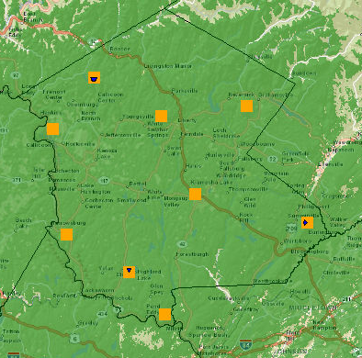
Coverage Projection (Mobile Outbound)

Slide 10
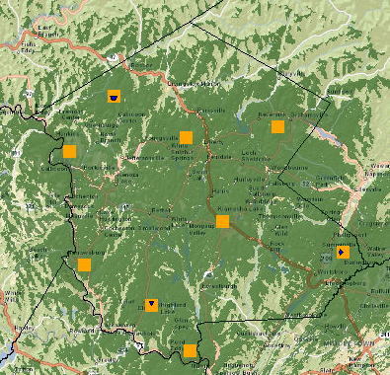
Coverage Projection (Port Inbound)

Slide 11
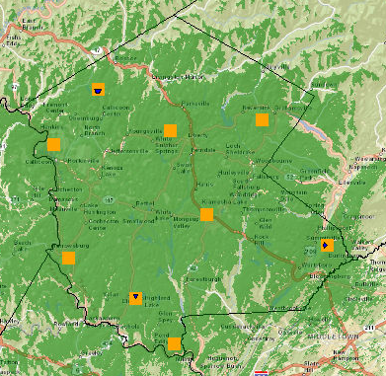
Coverage Projection (Port Outbound)

Slide 12
Tentative Channel Plan
BANK A 1. Fire & EMS Paging 2. Fire Communications 3. EMS Communications 4. Wide-area tactical repeater 5. Ground 1 6. Ground 2 7. Ground 3 8. Ground 4 9. Ground 5 10. EMS – Secondary 11. EMS - Hospital 12. EMS Statewide 13. TBD 14. TBD 15. TBD 16. TBD
BANK B (Interop) 1. Fire Communications 2. EMS Communications 3. Natl Interop – VHF Call 4. Natl Interop – VHF Tac1 5. Natl Interop – VHF Tac2 6. Natl Interop – VHF Tac3 7. Natl Interop – VHF Tac4 8. TBD 9. TBD 10. TBD 11. TBD 12. TBD 13. TBD 14. TBD 15. TBD 16. TBD

Slide 13
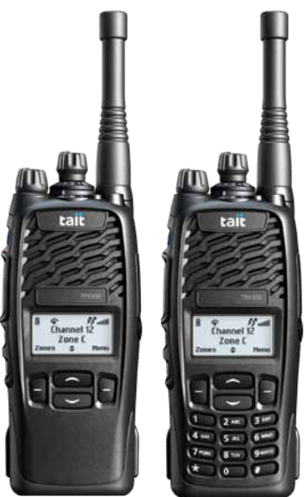
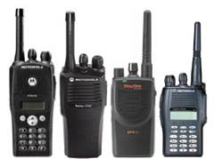
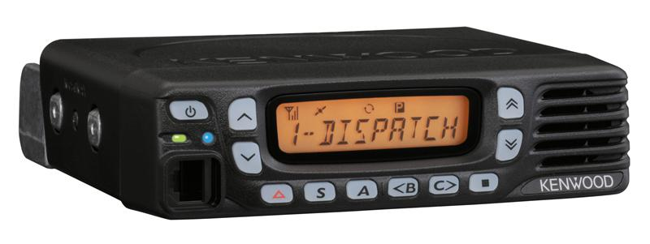
Equipment

Slide 14
End user radio equipment
Plan to procure equipment in 2016
You may push it to early 2017 if necessary
County bid (Strength in numbers)
State bid
County pager cache
Approximately 500 pagers
Will be distributed equally to fire & EMS departments
Figure 9 pagers per department

Slide 15
End user radio specifications
VHF High band (136-174 Mhz)
MDC-1200 signaling capable
Must be able to display 8 character unit/channel ID (UID)
Emergency Function
50W or 100W – user preference
P25 not required (Unless equipment is grant funded)

Slide 16
Budgetary Pricing
Check with YOUR radio vendor for specific pricing for YOUR agencies setup and operation
 | Mobile | Portable
Non-P25 | Kenwood TK790 50W - $1150 100W - $1500 | Kenwood TK2312K $256
P25 | Kenwood TK5710 50W - $1885 100W - $2286 | Kenwood TK5210 $1410
Can upgrade an existing lowband TK690 to a highband TK790 (keeping accessories) 50W = $560 100W = $905
*NYS Contract Pricing equipment only

Slide 17
Budgetary Pricing
 | Mobile | Portable
Non-P25 | Motorola XPR-5550 50W - $1600 | Motorola XPR-7550 $1146
P25 | Motorola APX-6550 45W - $2650 100W - $3051 | Motorola APX-4000 $1790
*NYS Contract Pricing equipment only

Slide 18
Budgetary Pricing
 | Pagers
Motorola Minitor 6 | $392.00
Unication | $425.00
*NYS Contract Pricing equipment only

Slide 19
QUESTIONS ?
Alex Rau
E911 Coordinator 845-807-0134
alex.rau@co.sullivan.ny.us

